Slide 1
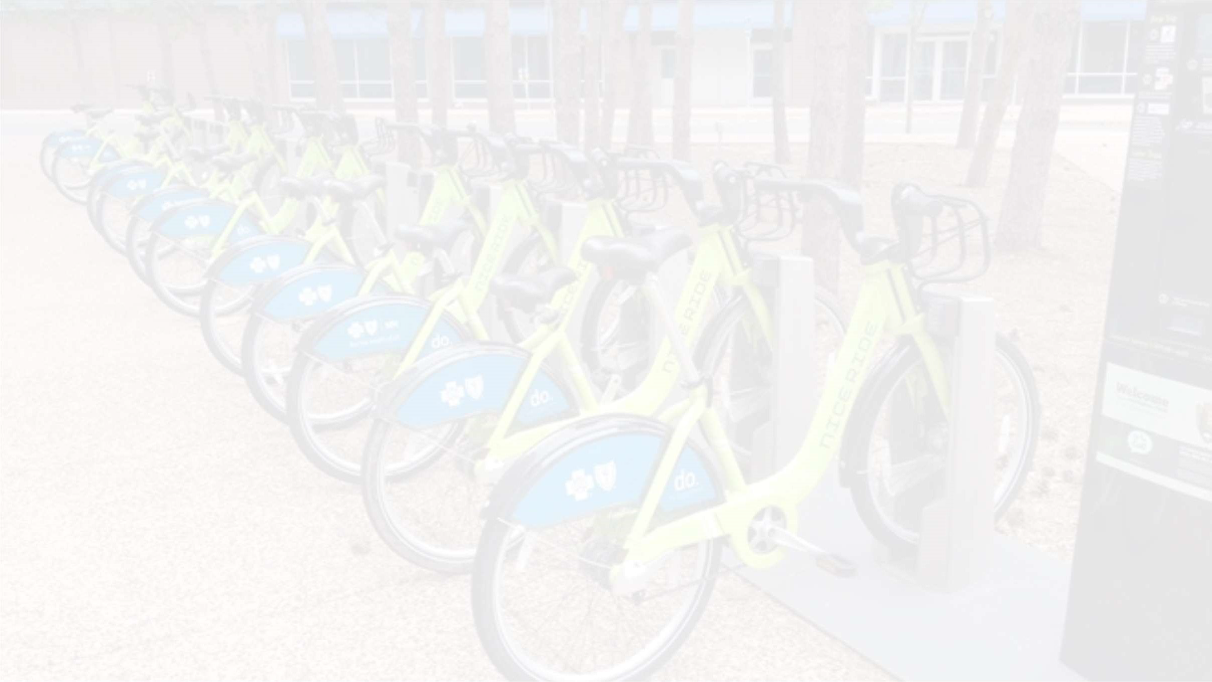


Bike Sharing Prediction
HEMANT GUPTA
210934106126
Data Science Project

Slide 2
All about this presentation:
Defining problem statement.
Overview of data.
Performing exploratory data analysis.
Model preparation.
Building different models.
Evaluation of all models.
Extracting the best model.

Slide 3
Problem statement
We are tasked with predicting the number of bikes rented each hour so as to make an approximate estimation of the number of bikes to be made available to the public given a particular hour of the day.

Slide 4
Overview of given data
We are given the following columns in our data:
Date : year-month-day
Rented Bike count - Count of bikes rented at each hour
Hour - Hour of he day
Temperature-Temperature in Celsius
Humidity - %
Wind Speed - m/s
Visibility - 10m
Dew point temperature - Celsius
Solar radiation - MJ/m2
Rainfall - mm
Snowfall - cm
Seasons - Winter, Spring, Summer, Autumn
Holiday - Holiday/No holiday
Functional Day - No(Non Functional Hours), Yes(Functional hours)

Slide 5
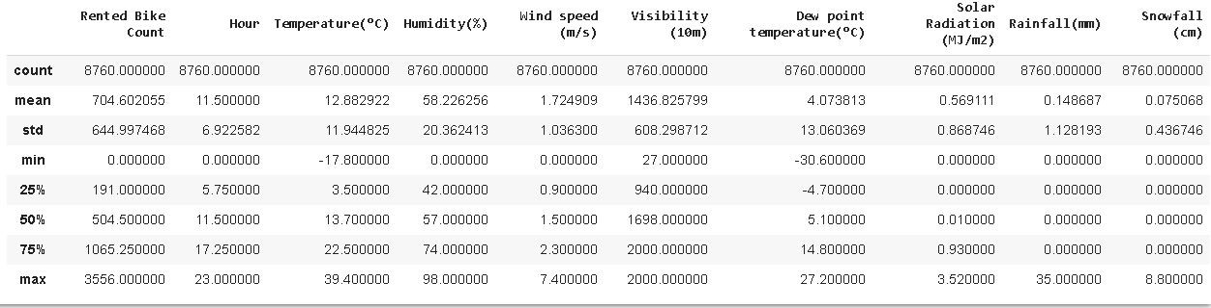
Description of data

Slide 6
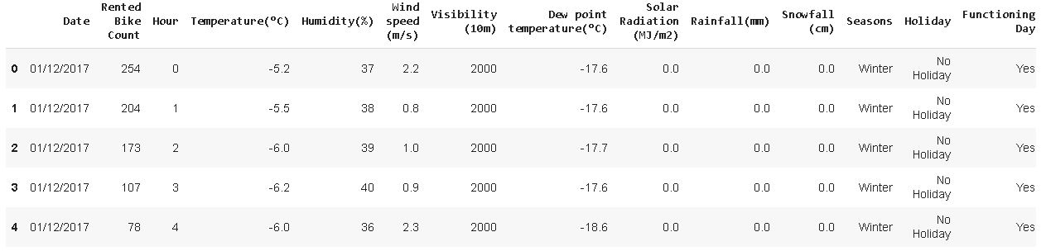
Sample of data

Slide 7
Exploratory data analysis
Exploratory Data Analysis refers to the critical process of performing initial investigations on data so as to discover patterns,to spot anomalies,to test hypothesis and to check assumptions with the help of summary statistics and graphical representations.
EDA is for seeing what the data can tell us beyond the formal modeling or hypothesis testing task.

Slide 8
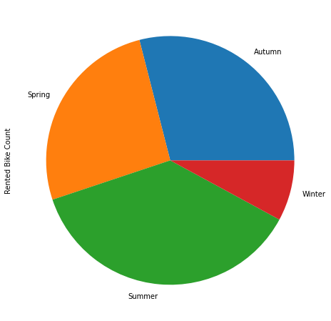
Comparison of bikes rented seasonally
Conclusions from above pie chart:
most bikes have been rented in the summer season.
least bike rent count is in winter season.
autumn and spring seasons have almost equal amounts of bike rent count.

Slide 9
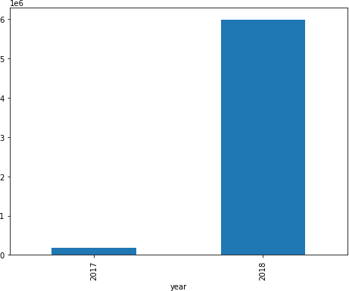
Comparison of number of bikes rented (year)
Above plot shows that most of the bikes have been rented in the year 2018.

Slide 10
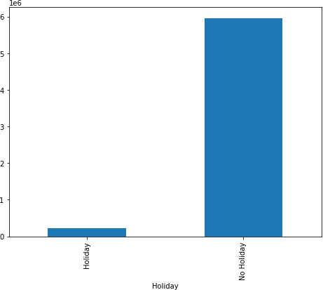
Comparison of number of bikes rented (type of day)
Above plot shows that most of the bikes have been rented on working days.

Slide 11
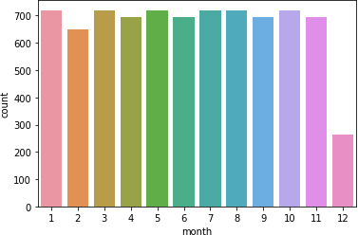
Comparison of number of bikes rented in year 2018
Above plot shows that most of the bikes have been rented in december (winter).

Slide 12
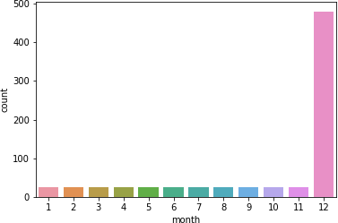
Comparison of number of bikes rented in year 2017
Above plot shows that most of the bikes have been rented in december in the year 2017.

Slide 13
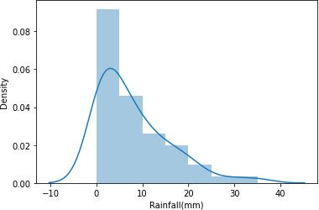
Distribution of bike rentals according to rainfall intensity
Above plot shows that most people tend to rent bikes when there is no or less rainfall.

Slide 14
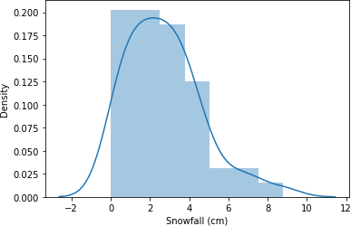
Distribution of bike rentals according to snowfall intensity
Above plot shows that most people tend to rent bikes when there is no or less
snowfall.

Slide 15
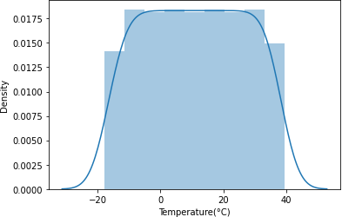
Distribution of bike rentals according to temperature intensity
Above plot shows that most people tend to rent bikes when temperature is between -5 to 25 degrees.

Slide 16
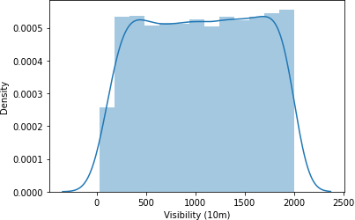
Distribution of bike rentals according to visibility
Above plot shows that most people tend to rent bikes when visibility is between 300
to 1700.

Slide 17
Model preparation
Plotting the correlation heatmap and removing variables which are highly correlated.
Calculating multicollinearity through VIF and filtering our data.
Converting data types of variables into relevant data types.
Filling the null values in our data with mean of particular values.

Slide 18
Models used
Linear regression model
Decision tree regression model

Slide 19
Challenges faced
Pre-processing the data was one of the challenges we faced which includes removing highly correlated variables from the data so as to not hinder the performance of our regression model.
Exploring all the columns and calculating VIF for multicollinearity was challenging because it might decrease the models performance.
Selecting the appropriate models to maximize the accuracy of our predictions was one of the challenges faced.

Slide 20
Conclusion
We are finally at the conclusion of our project!
Coming from the beginning we did EDA on the dataset and also cleaned the data according to our needs. After that we were able to draw relevant conclusions from the given data and then we trained our model on linear regression and other models Out of all models used , with extra-trees regression model we were able to get the r2- score of 0.85.The model which performed poorly was elastic net regularization with r2- score of 0.42.
Given the size of data and the amount of irrelevance in the data , the above score is good.

Slide 21
THANK YOU !

